Slide 1
Name: Charlie Joseph
Hollywood’s Most Profitable Stories

Slide 2
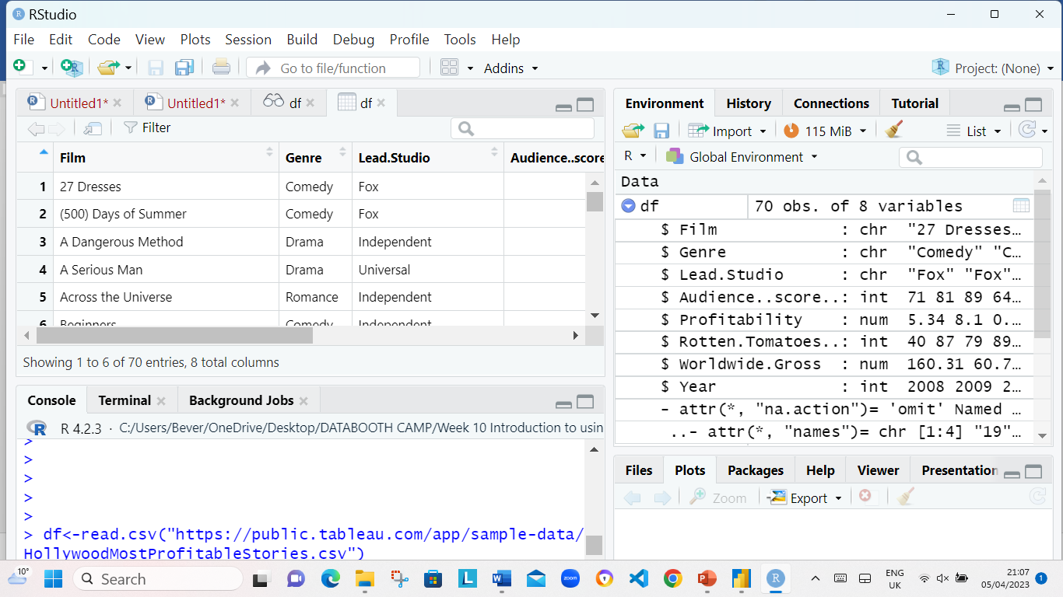
The data was loaded/imported into R using the codes line df<- read.csv(“https://public.tableau.com/app/sample-data/HollywoodsMostProfitableStories.csv") as seen in the screenshot below.

Slide 3
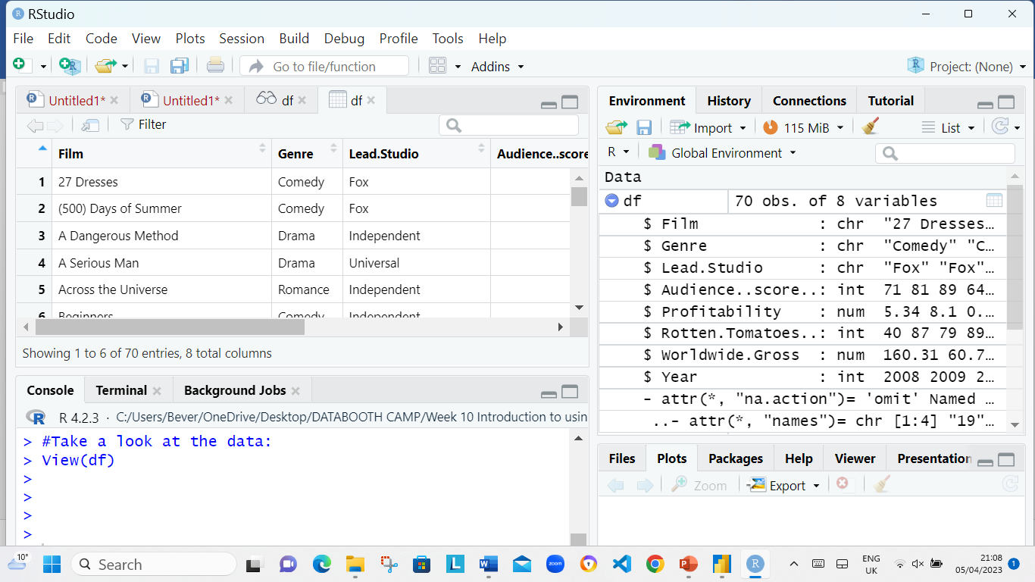
The data was looked at by using the following codes: View(df) as seen in the screenshot below.

Slide 4
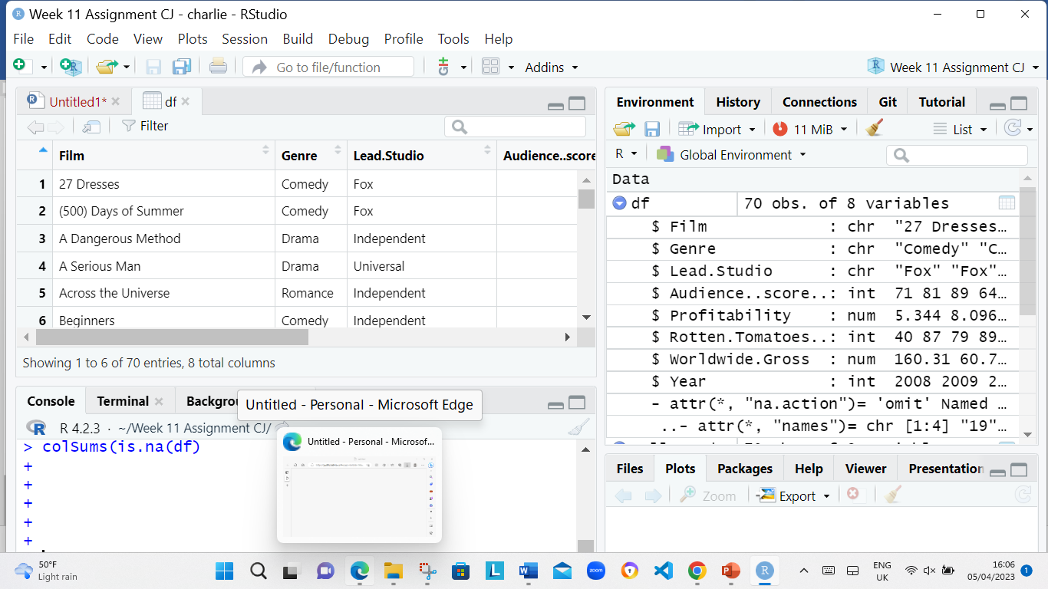
Cleaning Data
Th following codes was used to Check for missing values: ​colSums(is.na(df) as seen in screenshot below.

Slide 5
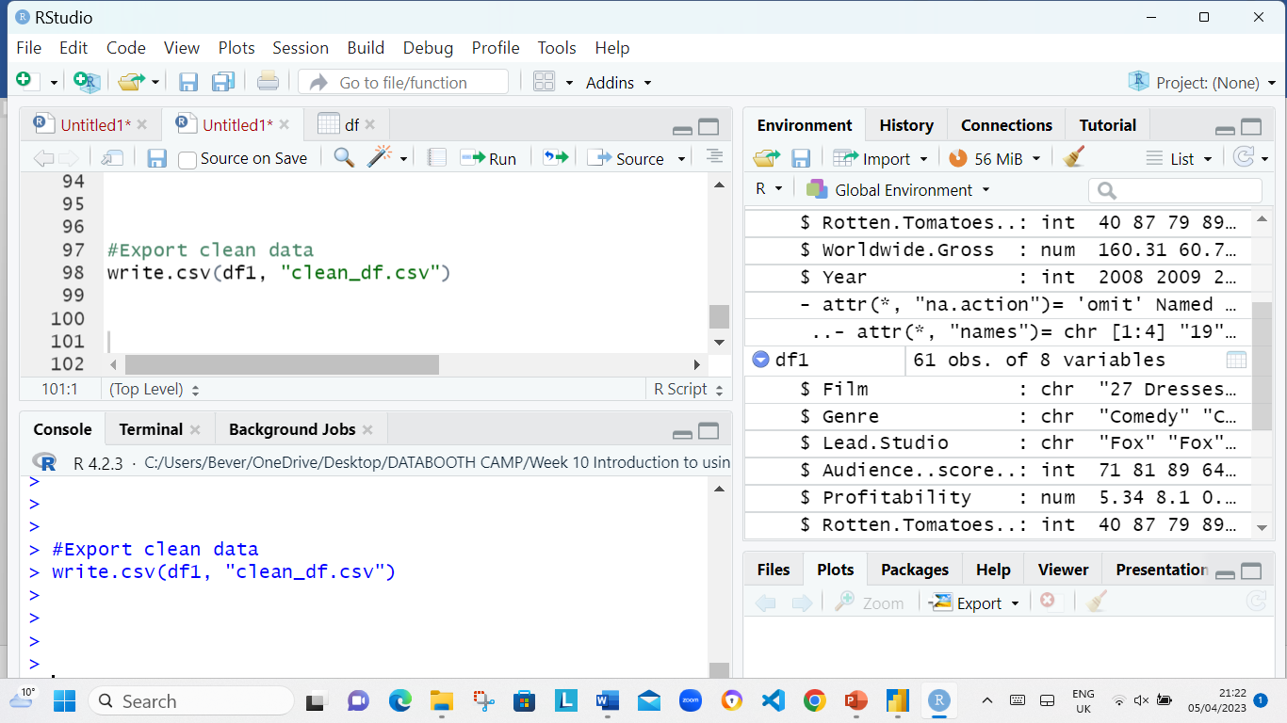
Export data The following codes was used Export clean data: write.csv(df1, “clean_df.csv")

Slide 6
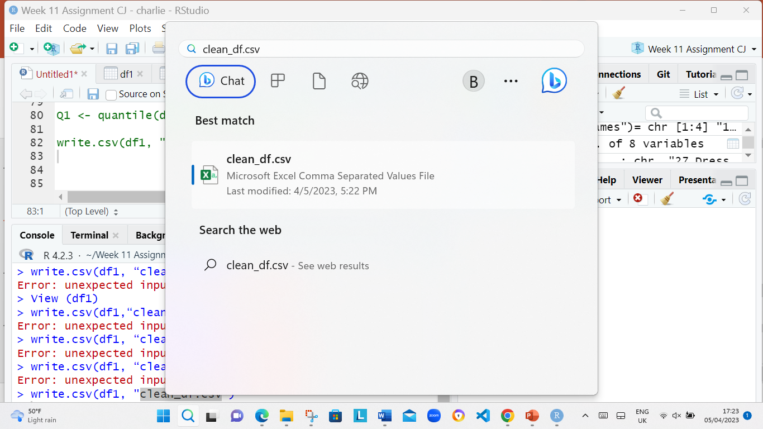
The following codes was used Export clean data: write.csv(df1, “clean_df.csv")

Slide 7
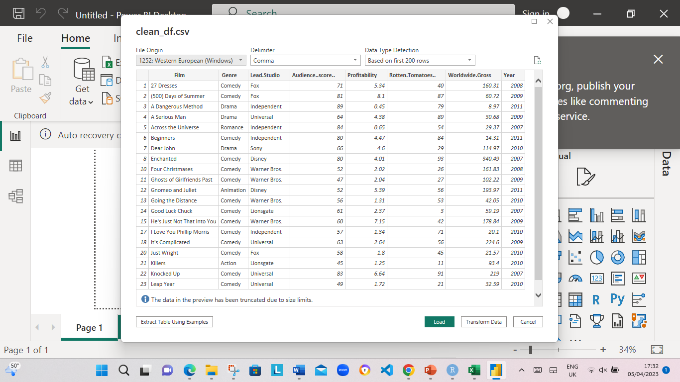
IMPORT clean_df.csv file into power B1

Slide 8
Power BI Dashboard that displays the following information listed below:
The average Rotten Tomatoes ratings of each genre
The number of movies produced per year
The audience scores for each film
The profitability per studio
The worldwide gross per genre

Slide 9
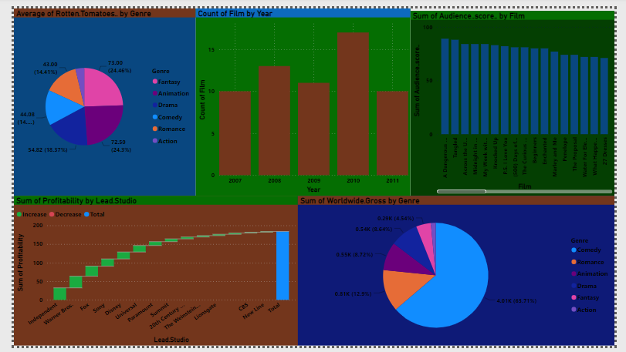

Slide 10
charliejgy4@gmail.com GitHub https://github.com/charliejgy4 The End! I will take any questions now please!! Thank you.

